Slide 1
Cyber Attackers
Attackers are individuals or groups who attempt to exploit vulnerability for personal or financial gain. As we’ve already seen, they are interested in everything, from credit cards to product designs!

Slide 2
QUIZ – What Color is my hat ? (White/Grey/Black)
While carrying out some research, this attacker stumbled across a security vulnerability on an organization's network that they are authorized to access.
This attacker used malware to compromise a company’s system and steal credit card information that was then sold to the highest bidder.
This attacker’s job is to identify weaknesses in a company’s computer system.
This attacker transferred $10 million into their bank account using customer account and PIN credentials gathered from recordings.
After hacking into ATM systems remotely using a laptop, this attacker worked with the ATM manufacturers to resolve the identified security vulnerabilities.

Slide 3
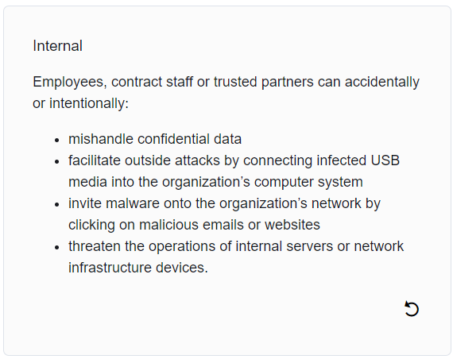
Internal and External Threat

Slide 4
What do you think ?
Remember that phishing email you received earlier from one of your customers?
An investigation into this email revealed that the user accounts and access privileges of a former employee were not fully removed from the IT systems on leaving the company. In fact, this former employee, who now works for a competitor, logged into @Apollo’s customer database only three days ago.
Has an internal or external security threat occurred here?

Slide 5
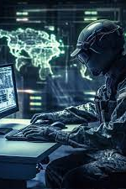
Cyberwarfare
Cyberwarfare, as its name suggests, is the use of technology to penetrate and attack another nation’s computer systems and networks in an effort to cause damage or disrupt services, such as shutting down a power grid.
Cyberwarfare is usually a state sponsored act, usually funded by a government.
Purpose Of Cyberwarfare The main reason for resorting to cyberwarfare is to gain advantage over adversaries, whether they are nations or competitors.
To impact another nation’s infrastructure e.g power grid
To gather compromised information and/or defense secrets

Slide 6

U.S Hack Iran – Example of Cyberwarfare

Slide 7
QUIZ
What level of cyber protection does each of the following factors require?
Your Identity ? (Government / Personal / Organizational)
A customers Database ? (Government / Personal / Organizational)
Economic stability ? (Government / Personal / Organizational)
An individual user profile on a social network site is an example of an (online / offline) identity ? _______
Which of the following pieces of information would be classified as personal data? (NIN / Driver license number / Date and place of birth / Job title / IP address)
Your neighbor tells you that they don't have an online identity. They have no social media accounts and only use the Internet to browse. Is your neighbor right? (Yes / No) ?
What are the 3 foundational principles for protecting information systems as outlined in the McCumber Cube? (Access / Integrity / Scalability / Availability / Confidentiality / Intervention) ?
What is a key motivation of a white hat attacker?
Why might internal security threats cause greater damage to an organization than external security threats?
Describe cybersecurity in your own way ?

Slide 8
Thank you for your time 😊

Slide 9
End Of Module One😊 > Module Two > Attacks, Concepts and Techniques

